Slide 1
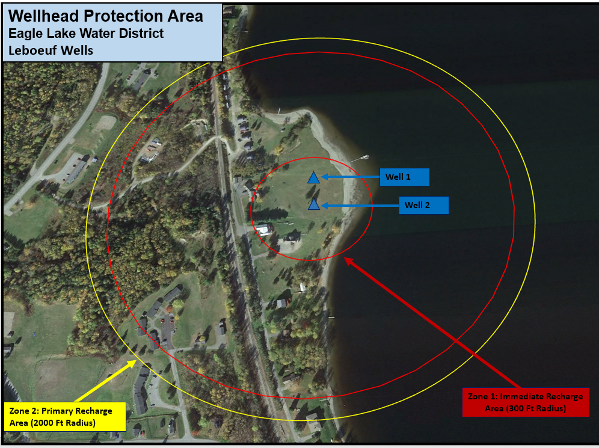
Zone 3: 500 Ft Radius (Protection Zone) Proposed

